Slide 1
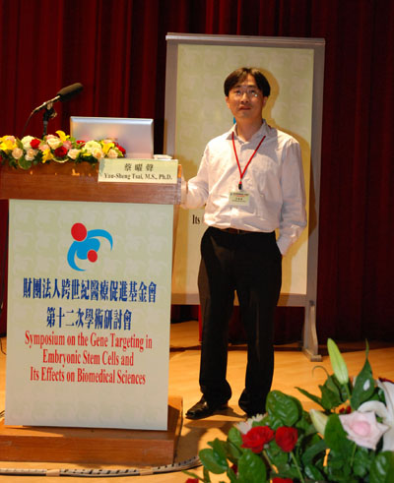
What happened if adipocytes sleep on a firm mattress?
Special Lecture
Dr. Yau-Sheng Tsai
(蔡曜聲教授)
Professor, Institute of Clinical Medicine, National Cheng Kung University
成功大學臨床醫學研究所
Research Interests :
1. PPARg in cardiovascular disease
2. PPARg in metabolic disease
3. Obesity and fat distribution
4. Inflammation and insulin resistance
5. Mitochondria and diseases
6. In vivo molecular imaging
Time:
Thursday, January 9, 2020, 1:30-3:30 PM
Location:
Room B201, Tzu Chi University (慈濟大學B201階梯教室)
Host:
Prof. Chung-Hsing Chang/ Institute of Medical Sciences,
Tzu Chi University (張中興教授/慈濟大學醫學科學研究所)
Open to the public – all are welcome!
醫學科學研究所
Institute of Medical Sciences
TEL: (03)8565301 Ext.2011

